Slide 1

PathFinder AI – Simplified
AI‐Powered Academic & Career Assistant
Guided by Bri. Krishnaprasad TR
Group number : A13
Aditya Kaashyap Emani AM.EN.U4CSE22007
Nirujogi Sai Jayanth AM.EN.U4CSE22037
Intha Madhav Reddy AM.EN.U4CSE22069

Slide 2
Outline
Introduction
Problem & Objective
Proposed Solution Overview
System Architecture / Design
System Workflow
Implementation Details
Results & Performance
Evaluation & Analysis
Challenges & Solutions
Conclusion
Future Scope
Publication Status
Project title

Slide 3
PathFinder AI is a full-stack career guidance platform for students and job seekers.
What it does:
• Maps resume/profile skills to real job requirements with explainable scores
• Recommends careers (KNN) and ranks jobs (Model 2 similarity + Doc2Vec fallback)
• Builds personalized learning roadmaps (Google Gemini) with gap analysis
• Adapts roadmaps from learner feedback using a constrained contextual bandit
Stack: React (UI) | FastAPI + SQLite (API/DB) | XGBoost, Doc2Vec, KNN | Gemini | ChromaDB RAG (chat)
Roles: Job seeker (profile, match, roadmap) and Recruiter (post/manage jobs)
Career platforms often give generic advice without clear job-fit reasoning.
PathFinder AI is a full-stack web platform (React + FastAPI + SQLite) for students and job seekers.
Two roles: job seeker and recruiter.
The system: KNN career suggestions; job ranking (Doc2Vec + importance-weighted similarity); Gemini roadmaps with gap analysis; contextual bandit adapts saved roadmaps from task feedback.
Stack: React, FastAPI, SQLite, ChromaDB (optional RAG), XGBoost, gensim Doc2Vec, Google Gemini.

Slide 4
Problem & Objective
Problem statement:
• Generic portals use keywords — weak explainability and no learning path
• Users cannot see which JD skills they lack or how important each skill is
• Static roadmaps do not react when a task is too hard or off-target
• Seekers and recruiters lack one integrated workflow
Objectives:
• JWT-secured dual-role web application
• Resume understanding + structured user profile
• Explainable job ranking (similarity %, matched/missing skills)
• Model 1: JD skill importance (core / important / supporting / optional)
• Model 2: weighted user–job similarity matching (not fit-class labels)
• Gemini roadmaps + contextual bandit adaptation from task feedback

Slide 5
Proposed Solution Overview
End-to-end pipeline:
1. Data & skills — 460-skill lexicon; competency extraction from JD text; resume skills via Gemini (local lexicon fallback on API limits)
2. Model 1 (XGBoost) — labels each JD skill by importance; cached on Job until JD changes
3. Model 2 (similarity) — scores user vs job 0–100 from weighted overlap, experience alignment, light lexical match; lists matched/missing/critical skills
4. Doc2Vec baseline — semantic embedding + 70/30 skill hybrid when profile is sparse
5. Gemini — phased roadmap JSON (role summary, gaps, tasks with jd_alignment)
6. Contextual bandit (ε=0.15) — 7 roadmap actions, 10-D state, action masking; Gemini rewrites tasks only when the bandit selects an edit action

Slide 6
Proposed Solution Overview
Design principles:
• Modular matchers: semantic (Doc2Vec) + structured (Model 1 + Model 2)
• Persist expensive JD analysis once per job (Model 1)
• Bandit for roadmaps only — not MDP/deep RL; safe masked exploration
• Optional RAG chat grounded in seeded career documents
User journey:
1. Register → build profile → upload resume
2. Career recommendations (KNN) + browse/search jobs
3. Job matching → ranked by similarity_score
4. Generate & save roadmap per job (upsert — survives refresh)
5. Per-task feedback: Complete | Too Hard | Too Easy | Skip & Regenerate
6. Phase 2: log interaction → recommend action → adapt roadmap
7. Recruiter posts jobs → Model 1 skills auto-analyzed on create

Slide 7
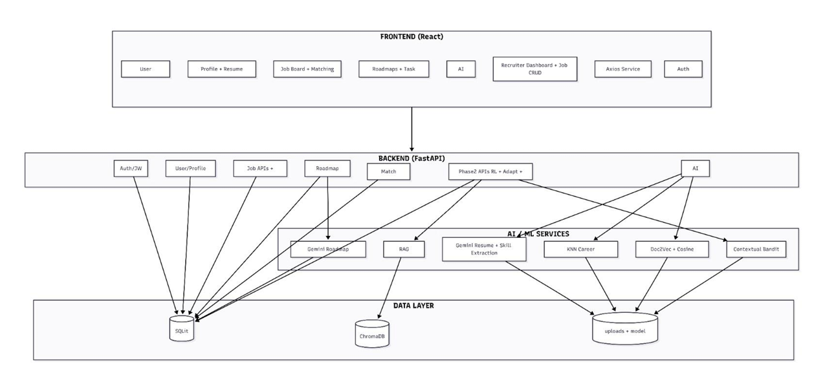
System context (C4-style):
• Actors: Job seeker, Recruiter
• PathFinder AI: React SPA + FastAPI API + SQLite
• External: Google Gemini API; optional ChromaDB vector store
Major containers:
• Frontend — routing, auth, job board, matching UI, roadmap detail, chat widget
• Backend — auth, jobs CRUD, profiles, match routes, Phase 2, roadmaps
• ML layer — KNN careers, Doc2Vec jobs, Model 1/2 services, rl_model.pkl bandit

Slide 8
System Architecture / Design
Layers & deployment:
• Presentation: React SPA — http://localhost:3000
• API: FastAPI + uvicorn — http://localhost:8001 (Swagger /docs)
• Persistence: SQLite pathfinder.db; Alembic migrations
ML / AI services:
• KNN + MultiLabelBinarizer — career recommendations
• gensim Doc2Vec — job embedding similarity (fallback matcher)
• Model 1 — XGBoost skill importance (model1.pkl)
• Model 2 — rule-based similarity scoring (uses Model 1 output at runtime)
• Bandit — rl_model.pkl, 7×10 linear policy, ε-greedy 0.15
• Gemini — roadmaps + optional task rewrites; ChromaDB RAG for chat
Training data: datasets/ (799 jobs, 12K skill rows, skills.json lexicon)

Slide 9
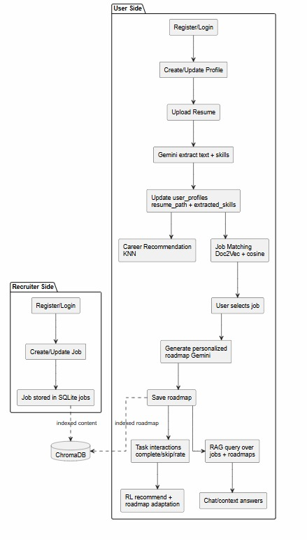
Runtime workflow:
Seeker: Login → Profile/Resume → POST /api/ai/recommend-careers (KNN)
→ Search jobs → POST /api/ai/match-jobs (Model 2 rank, Doc2Vec fallback)
→ Job detail → POST /api/jobs/{id}/generate-roadmap-for-user (Gemini)
→ Save roadmap (upsert per user+job)
Adaptation loop on roadmap task:
→ POST /api/phase2/interactions/log (reward + credit assignment)
→ GET /api/phase2/recommend (masked bandit arm + valid_actions)
→ POST /api/phase2/roadmap/adapt (apply JSON edit; Gemini if needed)
Recruiter: POST job with JD → analyze-jd persisted → seekers match against stored skills

Slide 10
Implementation Details
Technologies:
• Frontend: React, React Router, Axios, JWT in localStorage
• Backend: FastAPI, SQLAlchemy, Alembic, Pydantic schemas, bcrypt/JWT
• Database: SQLite (dev); auto column migrate for jd_analyzed_skills fields
AI / ML libraries:
• scikit-learn (KNN), gensim (Doc2Vec), XGBoost (Model 1 training)
• sentence-transformers / MiniLM features in Model 1 pipeline
• google-generativeai (Gemini with model fallback chain)
• chromadb — RAG retrieval for chatbot
DevOps: start_all.bat; seed_rag.py; e2e_adaptive_roadmap_flow.py

Slide 11
Implementation Details
Implemented features:
• Auth: /api/auth/register-user | register-recruiter | token login
• Profile + resume upload; skill extraction
• Careers: POST /api/ai/recommend-careers
• Jobs: search/filter, compare (up to 3), detail, recruiter CRUD
• Model 1: POST /analyze-jd, GET /jobs/{id}/analyzed-skills (cached)
• Model 2: POST /match-user-job, POST /recommend-jobs; match-jobs uses Model 2 first
• Roadmaps: generate, get, upsert save per job
• Phase 2: interactions/log, recommend, roadmap/adapt
• Chat: RAG + session history per page context

Slide 12
Results & Performance
Training data:
• 799 balanced job postings; 12,375 (job, competency) rows; 460-skill lexicon
Model 1 — XGBoost JD skill importance (held-out test n=1,857):
• Accuracy 98.60% | macro-F1 97.32%
• F1 by class: core 0.97 | important 0.95 | supporting 0.99 | optional 0.99
• Key features: context_score (41%), section_score (37%)
Model 2 — similarity matching (production, not high/medium/low labels):
• similarity_score 0–100: weighted matched vs missing skills from Model 1 tiers
• Weights core×3, important×2, supporting×1, optional×0.5
• Blend 72% skills + 20% experience + 8% lexical; penalty for missing core skills
Roadmap bandit: ε=0.15, 7 actions, 10-dimensional state vector

Slide 13
Results & Performance
Demonstration scenarios:
1. New user — resume upload → skills on profile → KNN top careers
2. Job board — search by title/location/skills; open job detail
3. Job matching — list sorted by similarity_score with skill breakdown
4. Analyze JD — core/important skills visible; cached after first run
5. Generate roadmap — phases, gap_analysis, tasks; persists on reload
6. Too Hard on a task — bandit picks DECREASE_DIFFICULTY or ADD_PREREQUISITE; Gemini rewrites task JSON
7. Compare jobs side-by-side; recruiter flow creates job with auto skill analysis
User-visible explainability: similarity %, tiered skills, gap text, adaptation reason

Slide 14
Evaluation & Analysis
Objectives met:
• Full-stack dual-role platform with secure API
• Explainable matching (Model 1 tiers + Model 2 similarity lists)
• Personalized Gemini roadmaps stored per user–job pair
• Adaptive learning via constrained contextual bandit + masked actions
• Integrated recruiter job management
Analysis:
• Model 1 gives strong offline accuracy for JD parsing — reduces repeated LLM cost
• Model 2 similarity is interpretable and aligned with product (ranking, not classes)
• Bandit is appropriate for single-step roadmap edits with immediate feedback
• Doc2Vec retains value as semantic fallback for thin profiles

Slide 15
Evaluation & Analysis
Comparison with alternatives:
• vs keyword job boards: importance-weighted skills + learning roadmaps
• vs embedding-only match: adds Model 1 structure + explicit missing-skill lists
• vs static MOOC paths: feedback-driven roadmap edits with safety constraints
Strengths:
• Clear separation: Model 1 (JD), Model 2 (user fit), bandit (roadmap), Gemini (content)
• Reproducible training pipeline under data_pipeline/ and models/
• OpenAPI-documented REST API; modular services
Limitations:
• Gemini quota/billing required for best roadmap quality
• Jobs stored locally (no LinkedIn/Naukri API yet)
• Bandit does not re-rank jobs — only adapts study plans

Slide 16
Challenges & Solutions
Challenges:
• Noisy resumes and inconsistent JD formatting across 799 training jobs
• Gemini rate limits (HTTP 429) on free tier during demos
• Orchestrating KNN, Doc2Vec, XGBoost, similarity rules, bandit, and RAG
• Keeping valid roadmap JSON after adaptive edits
• Schema drift when adding jd_analyzed_skills columns to existing DBs
Solutions:
• Weak-label + feature pipeline for Model 1; persist analysis per job fingerprint
• Gemini model fallback list + local resume skill extraction
• model2_service as single similarity API; Phase 2 three-step adapt flow
• Action masking (e.g. no skip when jd_importance ≥ 0.7)
• ensure_job_analysis_columns() on API startup; Alembic migrations

Slide 17
Conclusion
PathFinder AI integrates career discovery, explainable job matching, and adaptive learning:
• Profile/resume → KNN careers → Model 2 ranked jobs (+ Doc2Vec fallback)
• Model 1 structures every JD; Model 2 scores user alignment transparently
• Gemini produces roadmaps; contextual bandit personalizes them from real feedback
• Recruiters and seekers share one platform and data model
Deliverable: working academic prototype with measurable Model 1 metrics and end-to-end demo path suitable for final review and viva.

Slide 18
Future Scope
Future scope:
• Cloud deploy (Docker); PostgreSQL for production
• External job feed APIs (LinkedIn, Indeed adapters)
• Stronger RAG: automated indexing, citation in chat answers
• Mock interviews and automated resume scoring
• Larger labeled datasets; A/B tests on bandit reward shaping
• Multilingual JD/resume support
• Deep RL only if a simulated long-horizon environment is added — bandit remains the right v1 for local roadmap edits

Slide 19
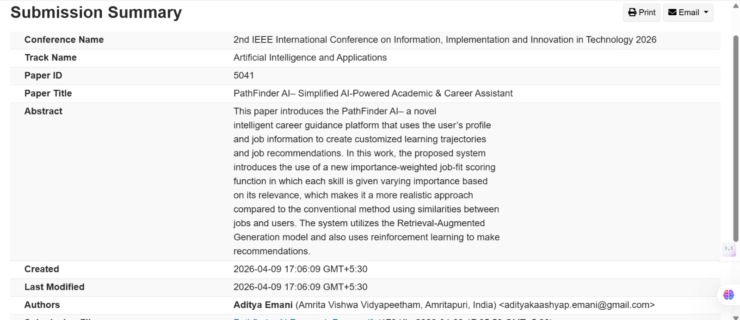
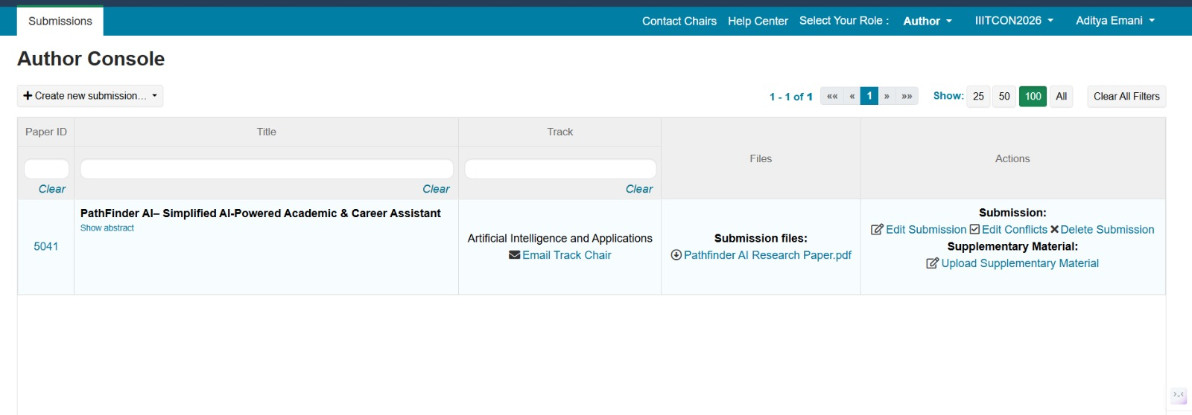
Publication status
Conference: 2nd IEEE International Conference on Information, Implementation and Innovation in Technology (I2ITCON 2026)
Publisher : IEEE
Date of conference : 10th April 2026
Accept Status : Not yet confirmed

